Slide 1

Data-driven Residential Energy Carrier-agnostic Demand Response Tools and Multi-value Services
Alessandro Rossi, Engineering
Project Manager, WP4 Leader

Slide 2
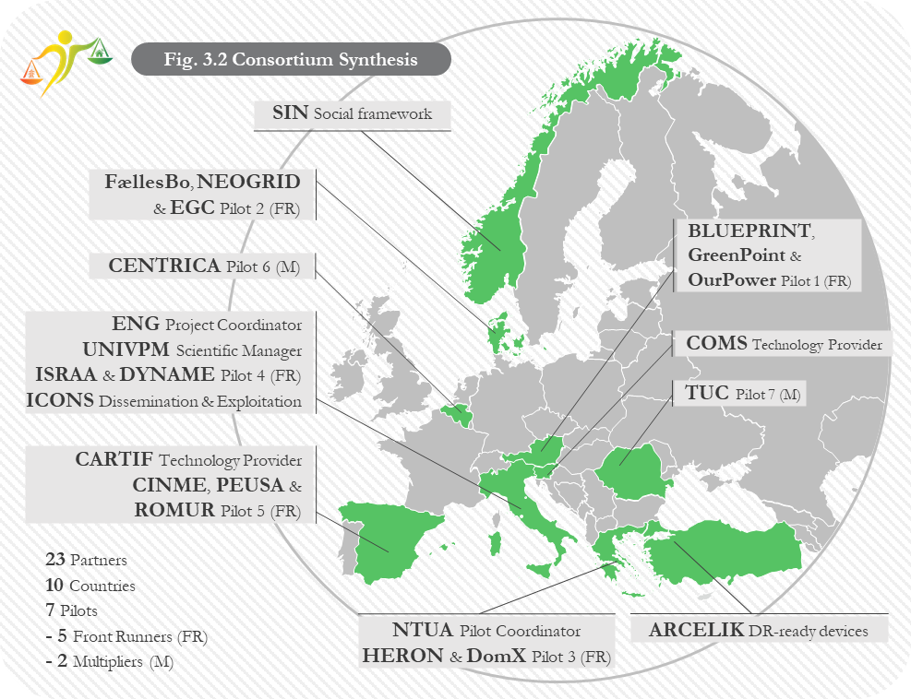


Project Identity Card
H2020 Call: HORIZON-CL5-2022-D4-01 /HORIZON-CL5-2022-D4-01-01
Starting Date: 1st May 2023 – Duration: 36 months
Total Costs: 7.359.075,00 Euro
EU contribution: 5,999,801.25 Euro (Innovation Action)
Partners: 23 (21 Full beneficiaries + 2 Affiliated Entities )
Country Coverage: 10 Countries (8 member States + 2 Associated Countries)
  Italy, Slovenia, Greece, Spain, Austria, Romania, Denmark, Belgium, Norway, Turkey

Slide 3
The Consortium
Large Companies
  ENG leading on advanced ICT and data-driven and dataspace technologies
  ARC, leading on Smart Appliance Manufacturer and integrator
Buildings Value Chain stakeholders:
  FaellesBo as Social House Company, ISRAA as Public Care Service provider, GreenPoint as Building Operator
Energy Value chain stakeholders:
    OurPower as Energy Cooperative, PEUSA as Electricity DSO, HERON as utility engaged in production, supply and trading of electricity, CENTRICA as a leading European independent DR aggregator specialised in automated DR , DYNAME as Energy Trader
Research & Academy Institutions (NTUA, UNIVPM, CARTIF, CIMNE, TUC)
Policy Making Support (GREENCITIES)
Social Sciences and Humanities (SSH) (SIN, ICONS)
5 Leading-edge SMEs focused on
  Strategic consultancy on innovative DR business models (BLUEPRINT)
  data-driven automated energy edge/IoT metering (COMS)
  IoT smart and flexible natural gas boilers retrofitting solutions (DOM-X)
  data-driven energy efficiency and flexibility services for heat commodity and district heating (NEOGRID)
  BESS integration and IoT solution provider for BMS (ROMUR)

Slide 4
The Context
Huge flexibility potential in the residential buildings sector
Decreasing costs of innovative data-driven ICT technologies and IoT-oriented smart appliance BUT
Socio-economic challenges
  Insufficient awareness of the value of individual energy consumers flexibility
  Business models immaturity preventing DR value sharing and propagation along energy and buildings value chains
  Lack of appropriate yet attracting beyond-financial incentives and compensation stimulating residential consumers engagement
  lack of a multi-value multi-commodity perspective for residential DR
Technological challenges
  Huge protocols fragmentation and heterogeneity and insufficient technical interoperability
  Smart appliances are smart enough BUT are not DR-ready
  Lack of dynamic and closer to real-time coordination to really support smart grids applications
  Lack of trusted and sovereignty-preserving DR data sharing environment (aka DataSpace)

Slide 5
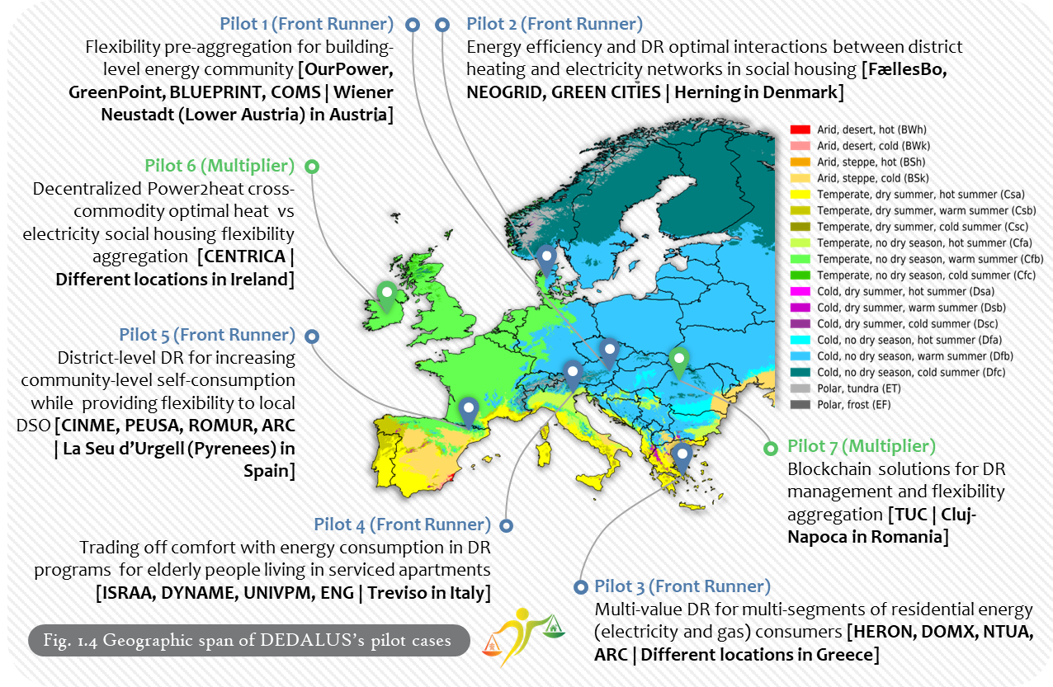
7 Real Life Pilots, across 7 countries
The DEDALUS framework is validated
in 7 Real-life Pilots across 7 countries:
5 Front Runners
2 Multipliers
Facilities examined:
Residential & commercial buildings
Energy community
Elderly housing facility
Social housing for immigrants & locals
University residence hall
We are covering to the largest possible extent the electricity and energy value chains, while considering also other non-energy sectors, such as buildings, mobility, storage, financial, comfort/wellness/health, older people

Slide 6
Main expected outcomes
14 Technology enablers to enable smart loads residential appliances into DR-ready flexible ones
A SSH-driven ensemble of tools and techniques combining sharing economy, co-creation and Design Thinking to engage residential energy consumers in DR at building-level
A Business layer focusing on designing and validating new DR building-centered business models
Notes:
DEDALUS Social, Technological and Business framework which consists of:
A data-driven stack of technology enablers to enable smart loads residential appliances into DR-ready flexible ones, which will leverage on and contribute to ongoing deployment of the Energy Data Space from HORIZON ENERSHARE, including.
technology adaptation, harmonisation and alignment of most prominent DR interoperability efforts and protocols (such as EFI, Open ADR2.0, USEF, EC BRIDGE Interoperability of flexibility assets) to enable DR-ready relevant assets
privacy preserving blockchain-based solutions technology enablers aimed to support trusted data governance and sovereignty and facilitate energy flexibility data sharing
Novel multi-value data-driven Human-aware DR flexibility management services and Building/District Digital Twins, exploiting available potential at different levels of flexibility aggregation (apartment-level, building-level, district-level and multiple buildings within a virtual building cluster, i.e. not geographically bounded buildings)
A SSH-driven ensemble of tools and techniques combining sharing economy, co-creation and Design Thinking to engage residential energy consumers in DR at building-level bring energy consumers center stage, engage and motivate them to share their energy data, through through appropriate design of beyond-financial DR incentives, such as the personal comfort.
A Business layer focusing on designing and validating new DR building-centered business models, while combining
Building-level DR service offering cost reduction through larger socialisation of the DR infrastructure (and DR-ready device costs deployment) than possible at individual apartment level;
revenue increases from service bundling and/or cross-commodity services (electricity vs heat) and/or cross-value chain services (energy vs healthcare/comfort, aging) may represent significant enablers

Slide 7
Main project objectives
Using SSH for a better engagement of energy consumers in the residential DR
Extension of ENERSHARE Energy Data Space Interoperability and Trust layer
Combination of eDREAM, BRIGHT, MATRYCS and DigiBUILD building-level data-driven models, algorithms and flexible assets DTs with end-users’ consumption and beyond consumption profiling models
To deliver data-driven, value stacking cross-stakeholder/cross-commodity/cross-value chain DR algorithms, models, and ICT-based services, for DR in energy-efficient residential buildings
To demonstrate, validate and replicate DEDALUS solutions through a number of different pilots
To develop new business models from sharing economy, multi-carrier system-level perspective and with social innovation and non-financial benefits capture for DR
To allow effective consumer participation in DR and further market opportunities by providing input to regulatory bodies to stabilise and harmonise the regulatory framework for residential DR, ensuring an efficient communication and dissemination, as well as alignment and synchronisation with European relevant initiatives and projects

Slide 8
Focus on user engagement strategy

Slide 9
Objectives
To make use of SSH-based tools and methodologies to facilitate the engagement of energy consumers in the residential DR
Use SSH-based methodologies like citizen engagement, co-creation, and Design Thinking to design an innovative concept for participatory, multi-value residential demand response (DR).
Develop financial and non-financial incentives to:
  Bundle flexibility for multiple markets
  Balance financial rewards with comfort preferences for consumer groups
  Support community benefits, like reducing energy poverty via energy sharing
Apply nudging techniques and analyze socio-economic, behavioral, and demographic factors to engage consumers inclusively. Use AI-based algorithms to segment buildings and consumers based on preferences and related KPIs.

Slide 10
Technology Enablers vs. Pilot deployment
​ Technological Innovations​ | Front Runners​ |  |  |  |  | Multipliers​
 | AU | DK | GR | IT | SP​ | IE | RO
TE-1: Consumers clustering and segmentation tools
TE-2: DR-ready connected smart appliances control and interoperability
TE-3: Residential DR/flexibility interoperability building blocks
TE-4: Flexibility modelling tool for residential DR
TE-5: DLT/Blockchain/Smart contracts solution
TE-6: Universal Secure Gateway
TE-7: Secure and Privacy/Confidentiality Preserving Data Transactions
TE-8: Digital Twins for consumer-aware optimal flexibility planning
TE-9: Comfort-based flexibility model
TE-10: Nudging Apps for near real-time closed-loop residential consumers activation and multi-vector DR
TE-11: Multi-value DR for virtual cluster of buildings
TE-12: P2P digital platform for trading pre-aggregated building flexibility
TE-13: District-level DR for self-consumption and cost optimization​
TE-14: Aggregation of flexible energy resources for district heating management

Slide 11
Co-creation workshops insights
Recommendations for increasing consumer engagement and social acceptance
Enhanced Information Campaigns | Develop comprehensive educational materials that clearly explain how DR programs work and the benefits of participation. Use various communication channels to reach a wider audience
Personalization and Technology Training | Offer technology that allows users to customize their energy settings to meet their comfort needs. Provide training sessions to improve comfort with smart devices and applications.
Transparent Data Practices | Ensure transparent communication about how personal data is collected, stored, and used. Provide reassurances and evidence of secure data management practices to build trust.
Focus on Community Engagement | In areas where community influence is strong, leverage this by encouraging neighbourhood-based participation strategies. Highlight community benefits and foster a sense of collective action.
Emphasize Environmental Benefits | For regions with strong environmental awareness, emphasize the positive environmental impacts of DR programs and demonstrate how DR programs benefit the environment. Use tangible evidence and success stories to illustrate these benefits
Notes:
Some general insights gained from the co-creation workshop:
Ensuring comfort is an essential driver for promoting DR participation
Lack of information is a common and significant barrier across all workshops
Iterative development of engagement and social acceptance practices is important and is going forward well
Value-stacking (e.g., financial savings + sustainability benefits) are more appealing than single-benefit approaches
The pilot countries with the nudging activity had tailormade nudging mock ups related to their specific tool and/or technology. The mock ups offered alternatives in terms of visuals that provided a basis for gathering feedback and comments from the participants. These comments and feedback was then gathered to make the tools and technologies more appealing and engaging for the users. Some examples of the tools and technologies presented in the nudging activities included mock ups about visual interfaces (e.g., graphs), messages (e.g., push notifications and SMS), and even NFTs.
For the Barriers and Drivers activity (Q-sort), a statistical technique called a Principal Component Analysis (PCA) was conducted. The number of participants was quite low from a statistical significance perspective. However, the purpose of the PCA analysis used in the barriers and drivers investigation was to provide an indication of users’ motivations in conjunction with other quantitative and qualitative data gathered from the other workshop tasks and previous data collection (e.g. the segmentation analysis prior to the co-creation workshops) to provide a comprehensive picture of the user population in each pilot.
The Social Acceptance Boosters (SABs) are tailored engagement and design recommendations that emerged from DEDALUS co-creation workshops (WP2) across the pilot countries. These are practical strategies to encourage participation in demand response (DR) schemes by addressing user needs, concerns, and motivations in each local context.
!! NB (Below are the overviews of the pilot country tailored SABs for reference. Not mandatory to talk about in the presentation, might be too much perhaps).
SABs for the pilots:
Austria:
Users are motivated by both financial and environmental benefits. Community contribution matters too, but less so. However, technology can be a barrier—so any new apps or devices should come with clear incentives and support. Since around 60% of participants are open to DR, communication should focus on inclusivity and information sharing to drive uptake.
Denmark:
Efforts should focus on involving more women in DR by raising awareness and simplifying technology. Tools should be easy to use or allow users to customize their experience to avoid disrupting daily routines.
Greece (DomX):
Interest in DR is high, and many users are open to adjusting their comfort. However, concerns remain about impacts on daily life and unclear financial benefits. Increasing engagement and public awareness activities—like events and better communication—could help address these concerns. Continued feedback on app design (UI/UX) is also key.
Greece (Heron):
Participants are generally knowledgeable and tech-savvy. Providing clear information through communication campaigns and in-app nudges can reinforce trust. More engagement activities and transparent benefits will keep interest levels high and help build wider acceptance.
Italy:
Community-centered engagement is vital—group events and education about the collective benefits of DR are encouraged. Comfort concerns should be addressed through reassurance, options for automation, and targeted training (especially for female users). Feedback on user interface preferences is important for aligning tools with user expectations.
Romania:
Awareness raising and highlighting personal benefits are central. Some users want recognition or rewards. Conflicting findings around automation mean that more engagement is needed to understand different user types. Offering customization options in tools could help accommodate varied needs and expectations.

Slide 12




Thank you!
DEDALUS-HORIZON.EU
@DEDALUS_EU
@DEDALUS_EU
INFO@DEDALUS-HORIZON.EU

